Slide 1
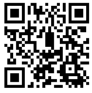
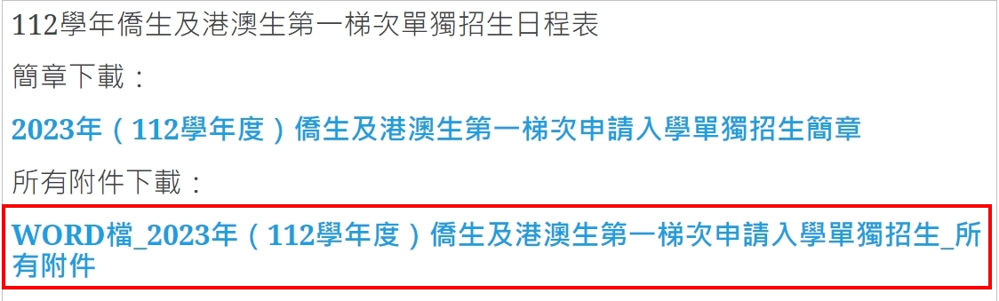
請下載附件表格並填寫繳交Download the Application Form that you need to fill in and upload
( Attachment 1 to 5)
https://admissions.tcu.edu.tw/?page_id=59

Slide 2
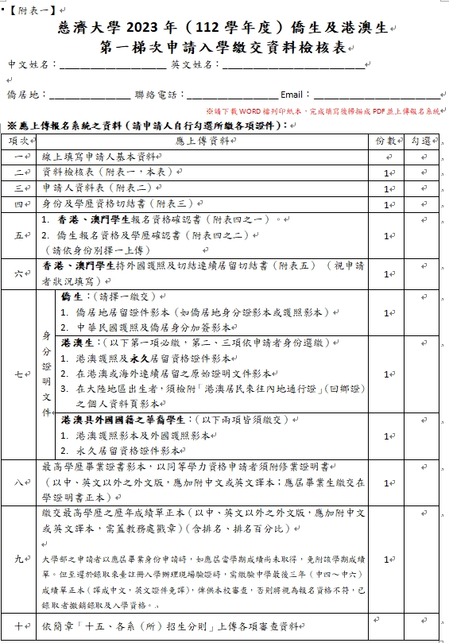
Attachment 1 –
Application Checklist
All boxes need to be ticked, with exception :
1.香港、澳門學生繳交【附表四之一】
2.僑生繳交【附表四之二】
確認您的身分後，繳交必繳文件
Check your identity
and submit the require documents

Slide 3
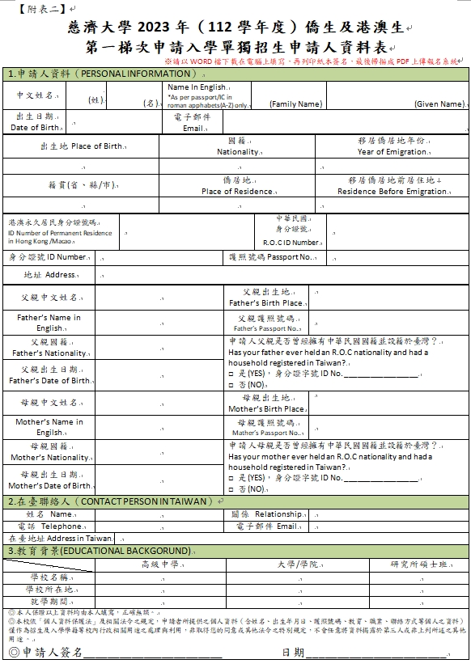
Attachment 2-
Application Form
空白處請盡量全部填寫完成
[ MAKE SURE ALL BOXES ARE FILLED
IN COMPLETELY ]
如果無在臺聯絡人，請填寫居住地的聯絡人
If you don’t have family/relatives in Taiwan, please write a contact from your own country
簽名處請簽名並填上日期
Remember to have your Personal signature
( Digital signature also acceptable)

Slide 4
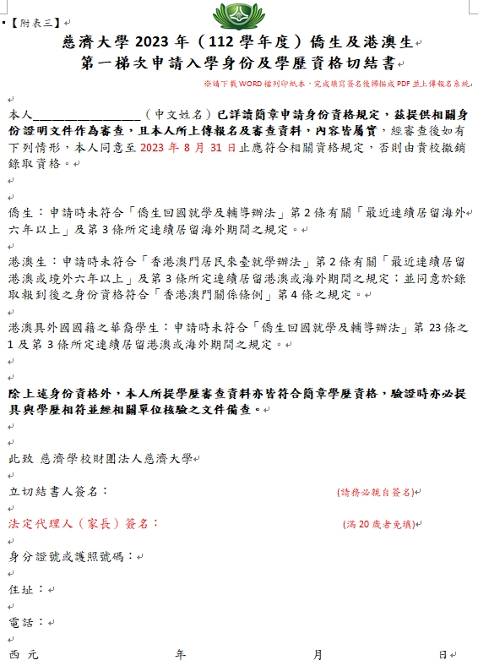
Attachment 3-
Status Check and Affidavit Form
請寫上您完整的中文姓名
Please write your full Chinese name
簽名處請簽名並填上日期
Remember to have your Personal signature
( Digital signature also acceptable)
ㄘㄩvvㄖㄩ
如果您未滿20歲，請法定代理人(家長)簽名並填上資料
If you are under 20 years old, please sign by the legal representative (parent) and fill in the following information
( Digital signature also acceptable)

Slide 5
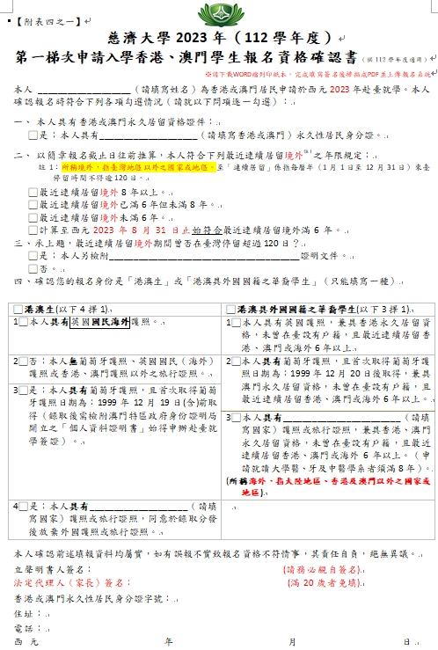
Attachment 4-1
Declaration Form
IMPORTANT NOTE :
若您是香港、澳門學生請使用此表，並填寫相關資訊
If you are a Hong Kong or Macau student,
please use this form and fill in the relevant information
簽名處請簽名並填上日期
Remember to have your Personal signature
( Digital signature also acceptable)
如果您未滿20歲，請法定代理人(家長)簽名並填上資料
If you are under 20 years old, please sign by the legal representative (parent) and fill in the following information
( Digital signature also acceptable)
ㄘㄩvvㄖㄩ

Slide 6
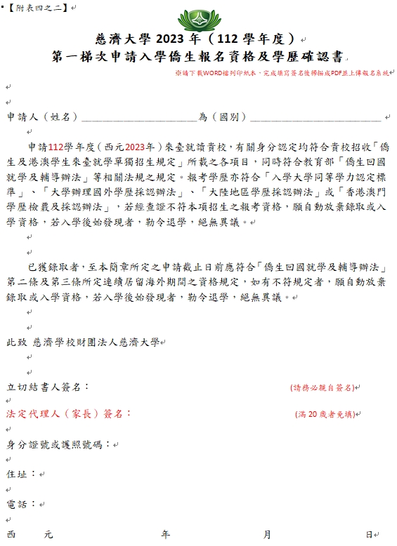
Attachment 4-2
Declaration Form
IMPORTANT NOTE :
若您是僑生請使用此表，並填寫相關資訊
If you are a Oversea Chinese student,
please use this form and fill in the relevant information
簽名處請簽名並填上日期
Remember to have your Personal signature
( Digital signature also acceptable)
ㄘㄩvvㄖㄩ
如果您未滿20歲，請法定代理人(家長)簽名並填上資料
If you are under 20 years old, please sign by the legal representative (parent) and fill in the following information
( Digital signature also acceptable)

Slide 7
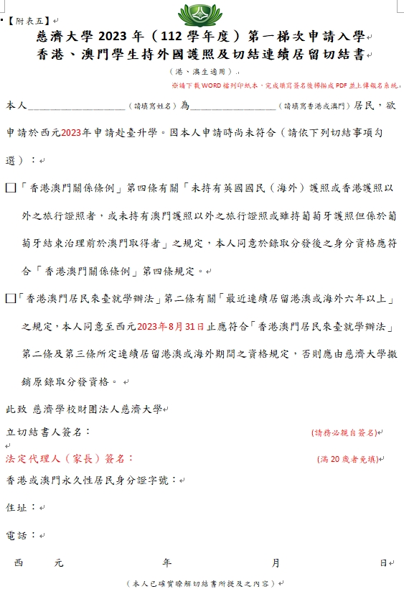
Attachment 5-
International Student Scholarship Form
IMPORTANT NOTE :
若您是香港、澳門學生並且【持有外國護照】請填寫此表
If you are a Hong Kong or Macau student and [hold a foreign passport], please submit this form.
簽名處請簽名並填上日期
Remember to have your Personal signature
( Digital signature also acceptable)
ㄘㄩvvㄖㄩ
如果您未滿20歲，請法定代理人(家長)簽名並填上資料
If you are under 20 years old, please sign by the legal representative (parent) and fill in the following information
( Digital signature also acceptable)

Slide 8


Email: tcuoia@gms.tcu.edu.tw
Thank you !
-TCU OIA-
Visit the TCU Linktree(information)
Scan the Qrcode

